Slide 1
Super-Resolution via Deep Learning
2017. 9. 8
손한빈

Slide 2
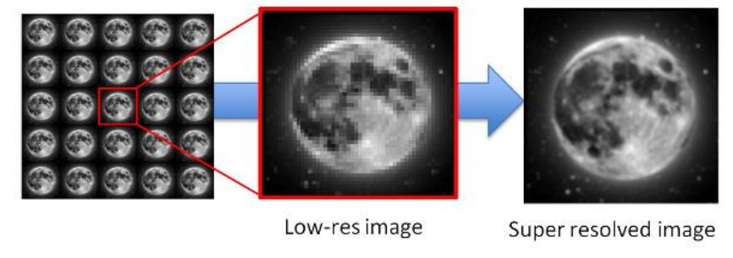
Super-Resolution?
Definition:
Generating high resolution (HR) image with more details using one or more low resolution (LR) images.

Slide 3
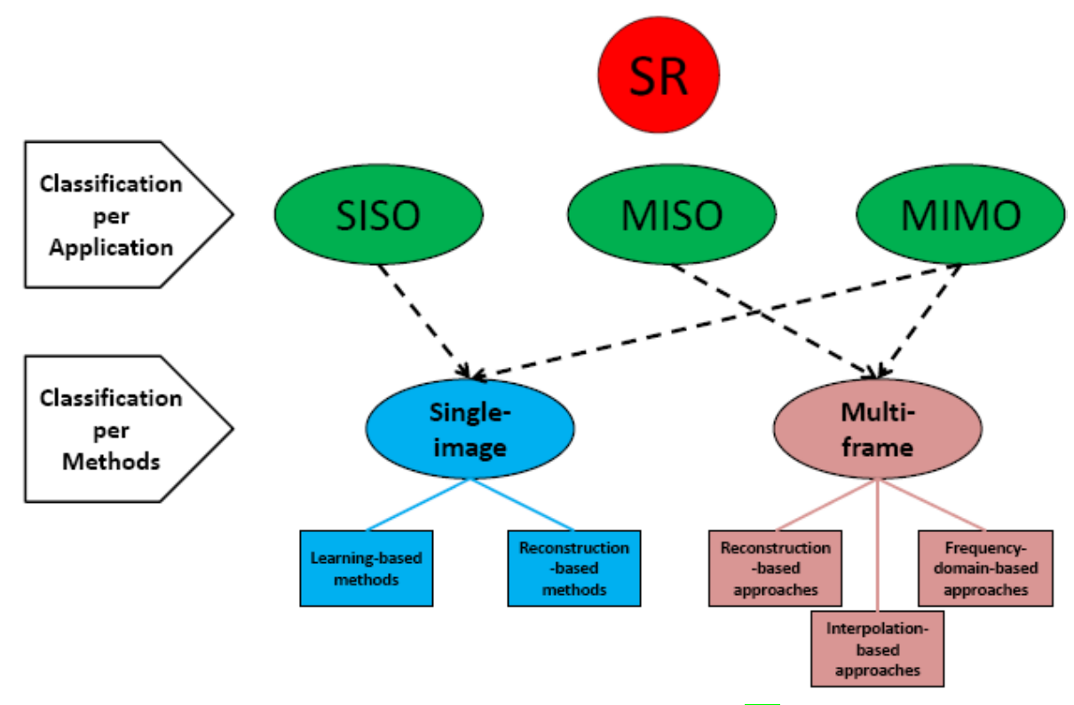
Classification of Super-Resolution

Slide 4
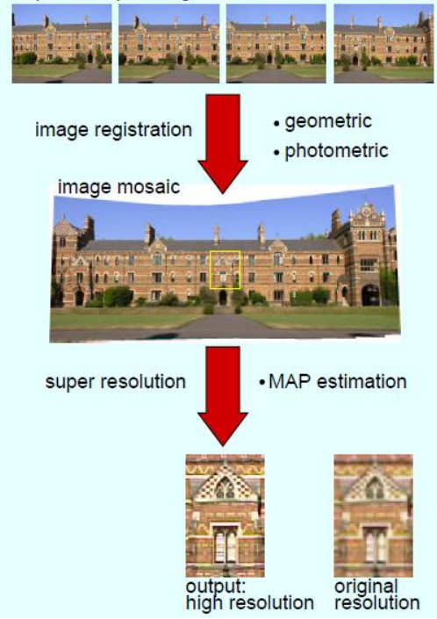
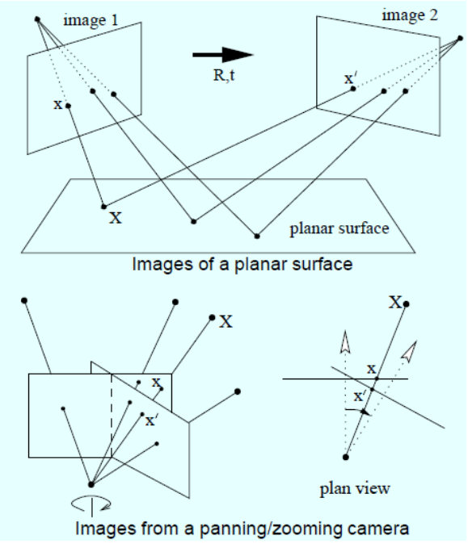
SR from Multiple Image

Slide 5
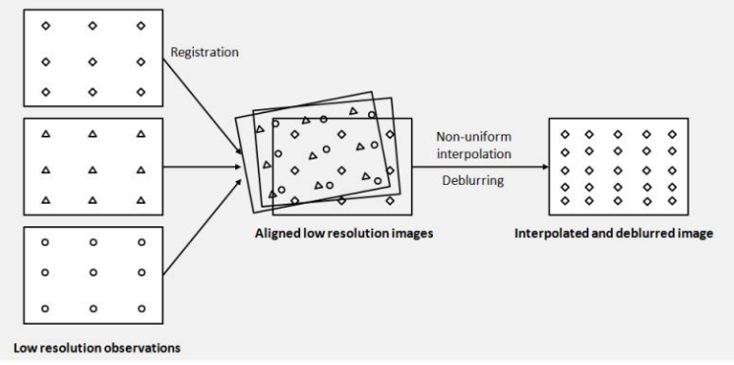
SR from Multiple Image
Each Image has different information of the same scenery.

Slide 6
SR from Single Image
Super-Resolution via example-based strategy
Example-Based Super Resolution (Freeman, CG&A 2002)
Neighbor Embedding (Chang, CVPR 2004)
Sparse Representation (Yang, TIP 2010)
Kernel ridge regression (Kim, PAMI 2010)
Locally-linear regression (Yang, ICCV 2013)
SR with Random Forest (Schulter, CVPR 2015)

Slide 7
SR from Single Image
Super-Resolution via Convolution Neural Network
SRCNN (Dong, ECCV 2014)
VDSR (Kim, CVPR 2016)
SCN (Zhaowen, ICCV 2015)
DRCN (Kim, CVPR 2016)
ESPCN (W.Shi, CVPR 2016)
FSRCNN (Dong, ECCV 2016)

Slide 8
SR from Single Image
Super-Resolution via Generative Adversarial Network
Perceptual Losses for Real-Time Style Transfer and Super-Resolution (ECCV 2016)
SRGAN(Photo-realistic single image super-resolution using a generative adversarial network) (CVPR 2017)
EnhanceNet: Single Image Super-Resolution Through Automated Texture Synthesis (ICCV 2017)

Slide 9
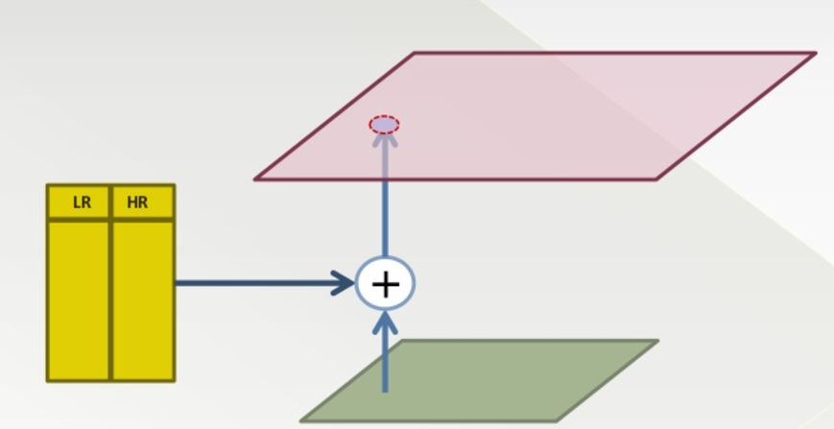
Example-based method
Image database with HR/LR image pairs
Replace similar LR patches with corresponding HR patches
Learn HR/LR patches form Internal or external datasets

Slide 10
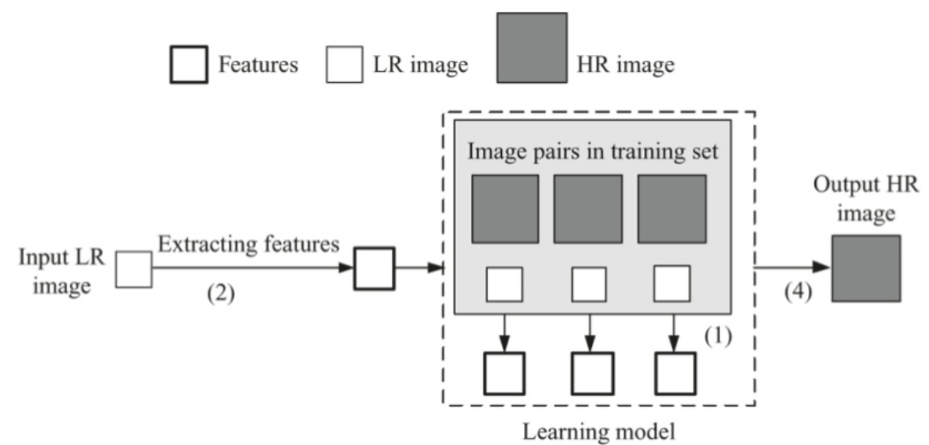
Example-based method
Correspondences between low-resolution and high-resolution images are learned from a set of training images.

Slide 11
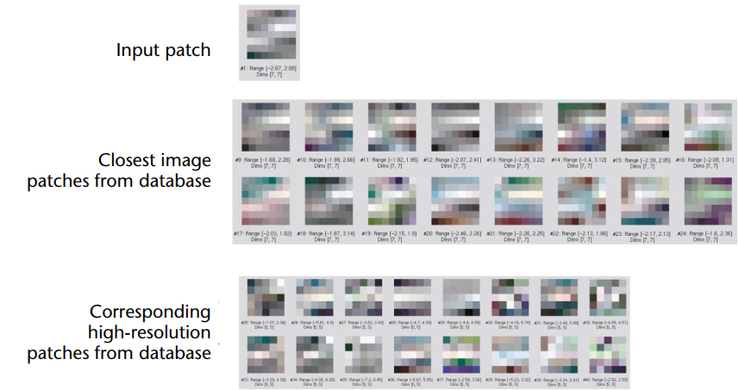
Example-based method

Slide 12
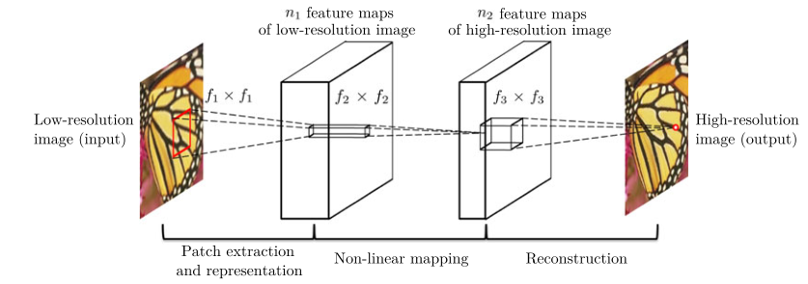
Deep Learning based method
SRCNN

Slide 13
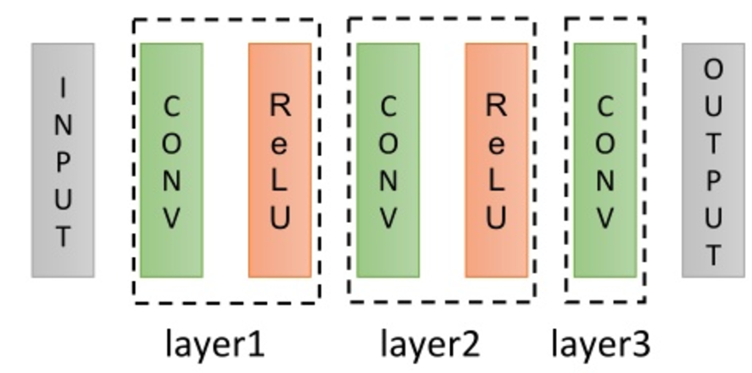
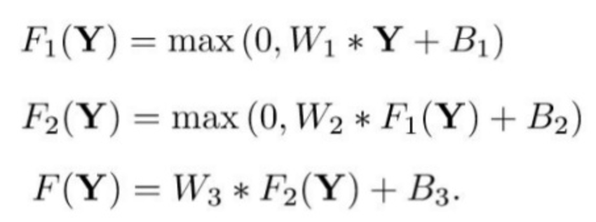
Deep Learning based method
SRCNN
Patch extraction and representation
- 64 filters of size Cxf1xf1 (1x9x9) 64*1*9*9=5184
Non-linear mapping
32 filters of size n1xf2xf2 (64x1x1) 32*64*1*1=2048
Reconstruction
-1 filters of size n2xf3xf3 (32x5x5) 1*32*5*5=800

Slide 14
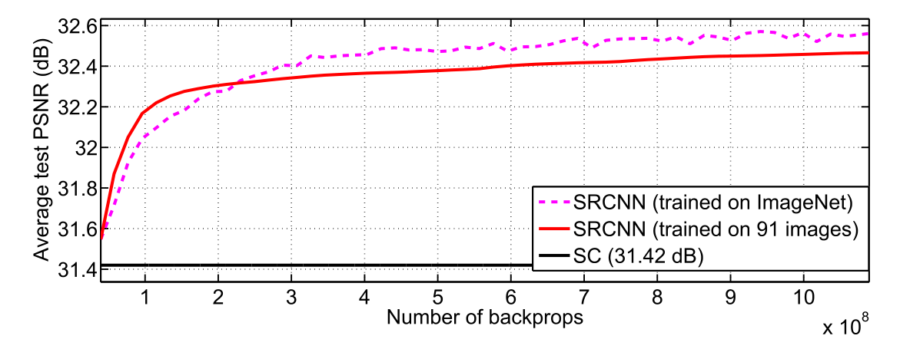
Deep Learning based method
SRCNN
Result

Slide 15
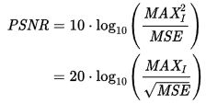
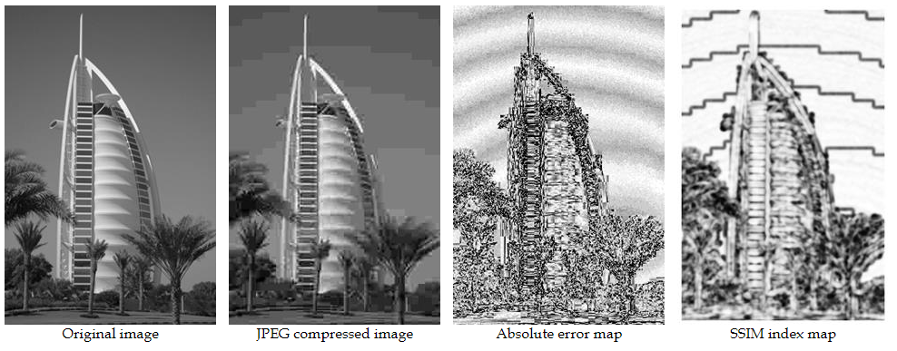
Deep Learning based method
PSNR vs SSIM
PSNR이 3dB면 줄어들면
MSE가 2배 증가(log 2 = 0.3010)

Slide 16
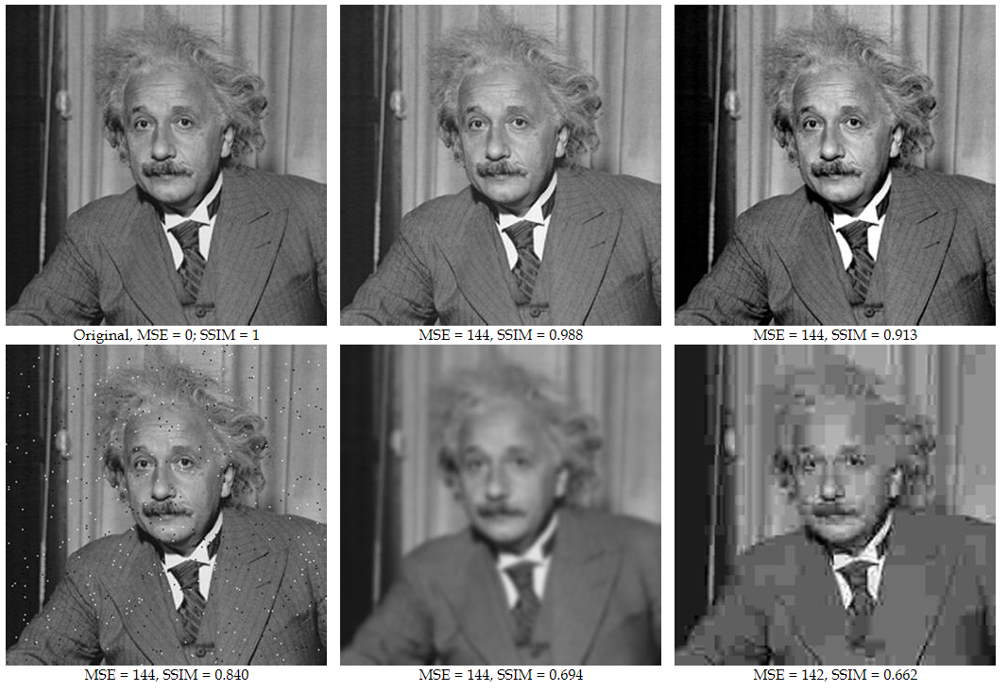
Deep Learning based method
PSNR vs SSIM

Slide 17
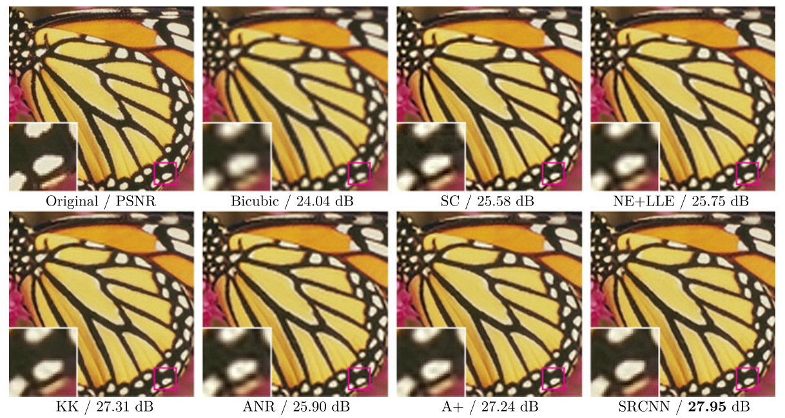
Deep Learning based method
SRCNN
Result

Slide 18

Deep Learning based method
SRCNN
Result

Slide 19
Deep Learning based method
SRCNN
Contribution
CNN like Sparse-coding
End-to-end learning
First work using Deep-learning

Slide 20
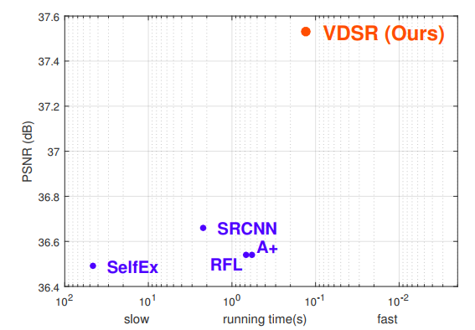
Deep Learning based method
VDSR
Accurate Image Super-Resolution Using Very Deep Convolutional Networks (Kim, CVPR 2016)

Slide 21
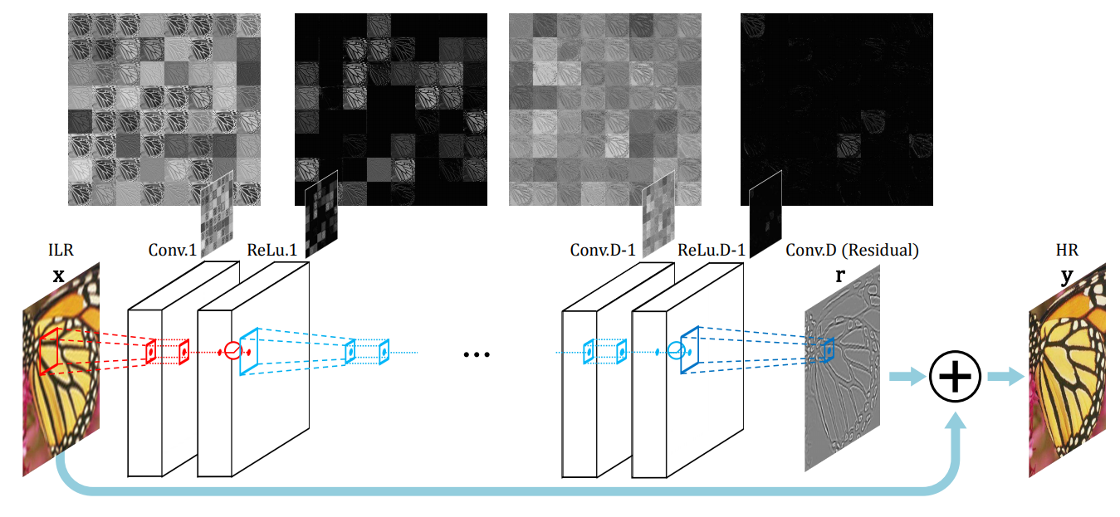
Deep Learning based method
VDSR

Slide 22
Deep Learning based method
VDSR
Convolution Neural Networks with 20 layers
Residual Learning
Adjustable gradient clipping with high learning rates
 | SRCNN | VDSR
Receptive fields | 13x13 | 41x41
Scale factors | x3 | x2, x3, x4
Learning rate | 10^-5 | Learning rate decay(10^-2, 10^-6)
Depth | 4 | 20

Slide 23
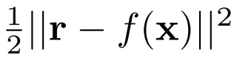
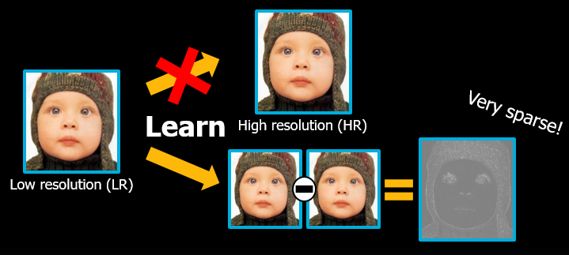
Deep Learning based method
VDSR
Residual Learning
End-to-end relation requires very long-term memory
Predict residual image r = y – x
Residual loss
, where f(x) is the network prediction

Slide 24
Deep Learning based method
VDSR
Residual Learning vs non-residual learning

Slide 25
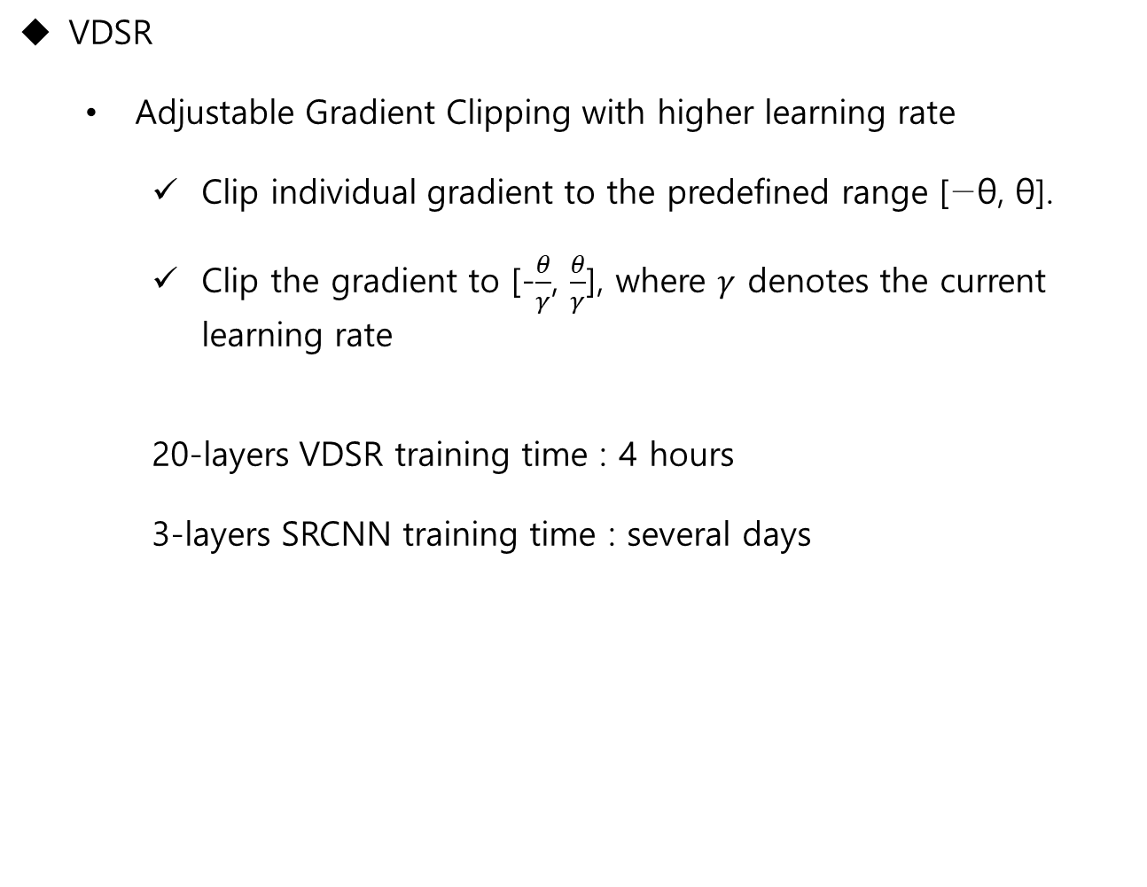
Deep Learning based method
VDSR
Adjustable Gradient Clipping with higher learning rate
Clip individual gradient to the predefined range [−θ, θ].
Clip the gradient to [-$\frac{θ}{γ}$, $\frac{θ}{γ}$], where $γ$ denotes the current learning rate
20-layers VDSR training time : 4 hours
3-layers SRCNN training time : several days

Slide 26
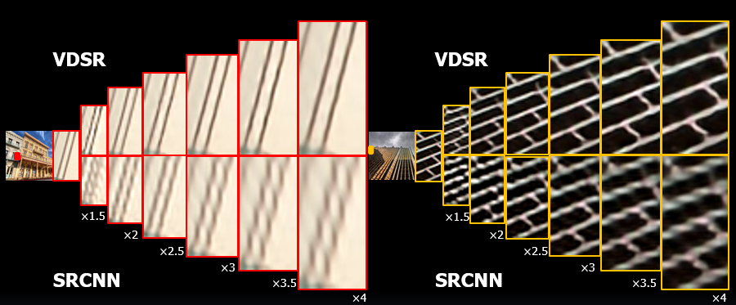
Deep Learning based method
VDSR Result

Slide 27
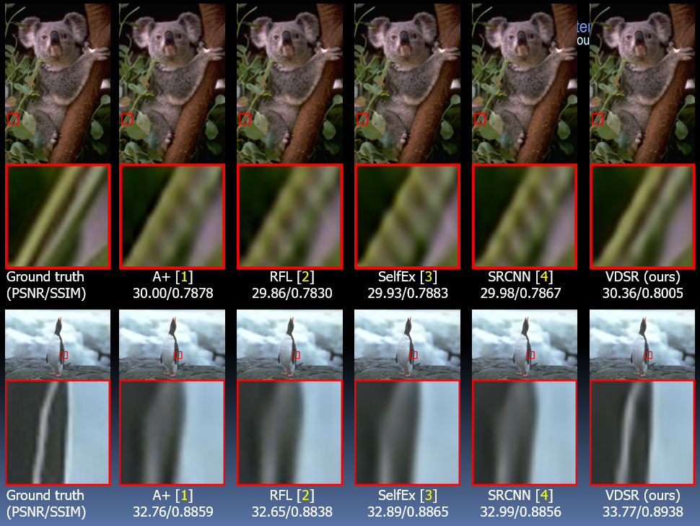
Deep Learning based method
VDSR Result

Slide 28
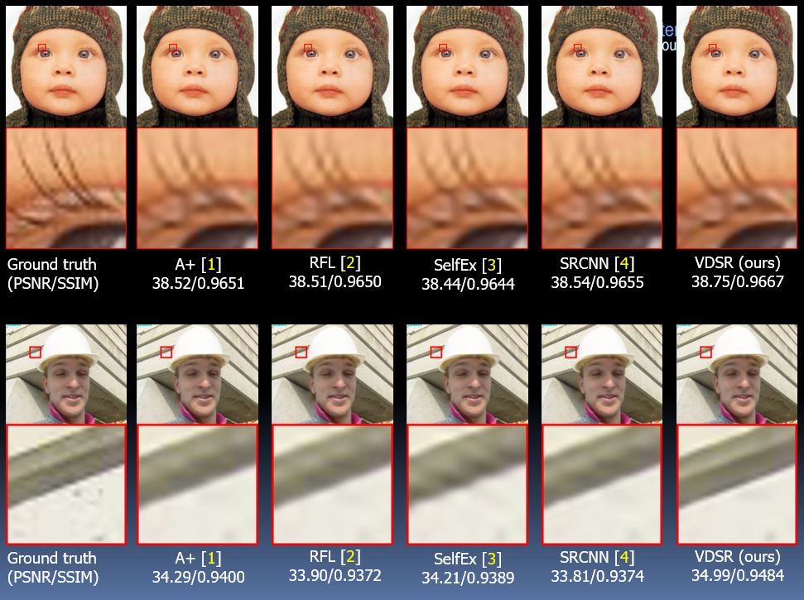
Deep Learning based method
VDSR Result

Slide 29
Deep Learning based method
VDSR
Contribution
Resolve the issue with residual-learning and gradient clipping
Boosting convergence rate with high learning rates

Slide 30
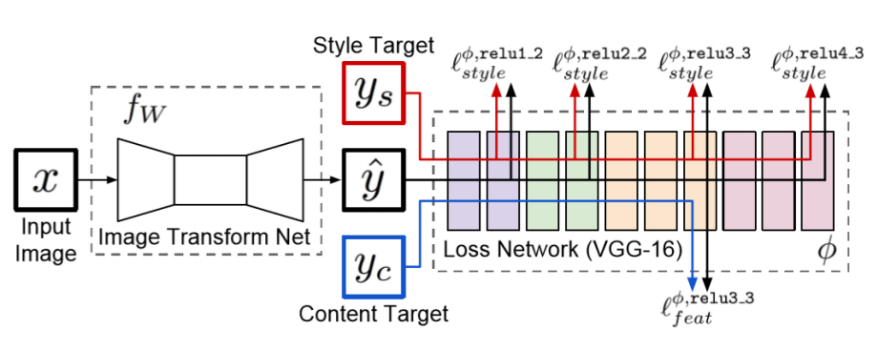
Perceptual Super-Resolution
Perceptual Losses for Real-Time Style Transfer and Super-Resolution
PSNR doesn’t guarantee perceptually comfortable SR
Teach the network to redraw
Image Transform Net
Loss Network

Slide 31
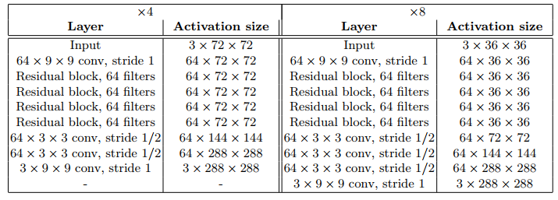
Perceptual Super-Resolution
Perceptual Losses for Real-Time Style Transfer and Super-Resolution
Image Transform Net
Loss Network
16-layer VGG network pre-trained on ImageNet

Slide 32
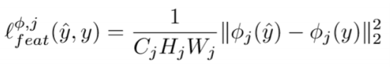
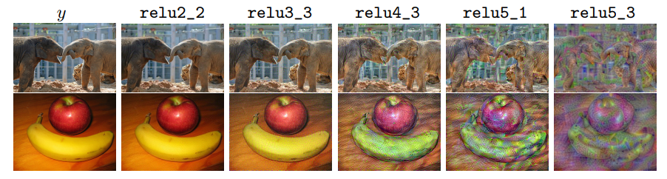
Perceptual Super-Resolution
Perceptual Losses for Real-Time Style Transfer and Super-Resolution
Feature Reconstruction Loss
As we reconstruct from higher layers, image content and overall spatial structure are preserved but color, texture, and exact shape are not.

Slide 33
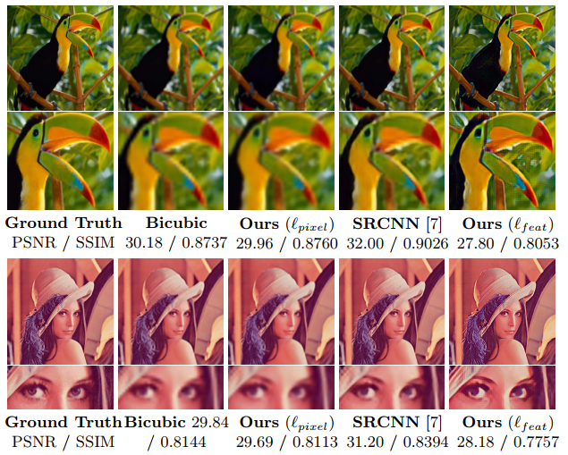
Perceptual Super-Resolution
Perceptual Losses for Real-Time Style Transfer and Super-Resolution
Result

Slide 34
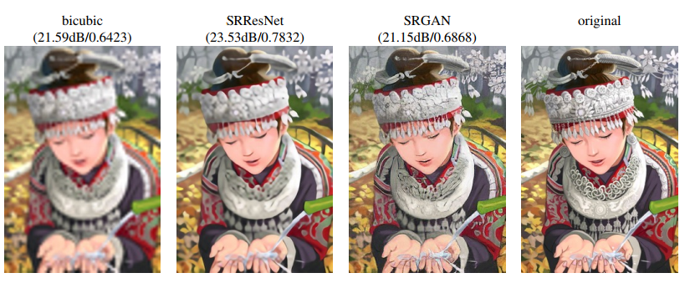
Perceptual Super-Resolution
SRGAN
Content loss + Adversarial loss

Slide 35
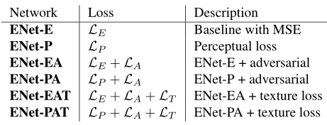
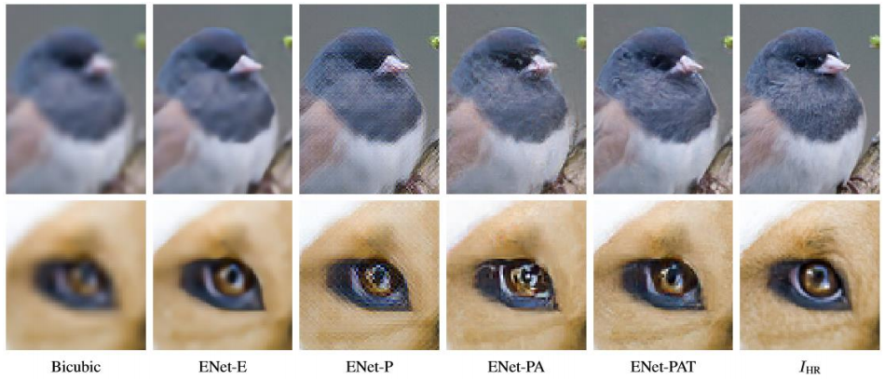
Perceptual Super-Resolution
EnhanceNet

Slide 36
Thank you !!
Q & A

